Slide 1
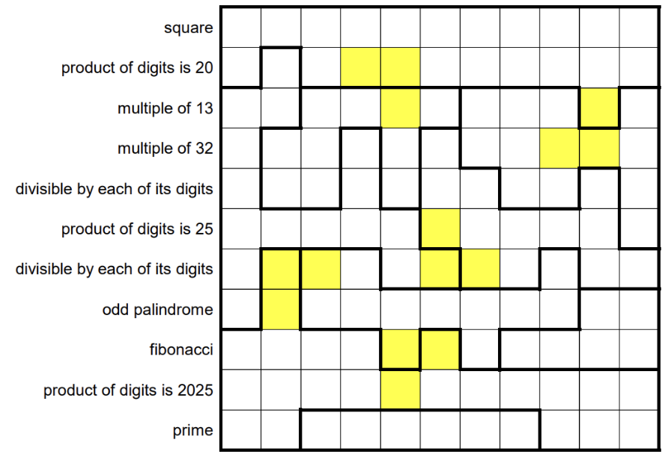

Slide 2
2/0 | 3 | 4 | 2 | 2 | 2 | 5 | 2/0 | 3 | 2 | 4
5 | 4 | 2/0 | 2X | 2X | 5 | 2/0 | 2 | 5 | 2 | 2/0
4/0 | 5 | 3 | 4 | 3X | 3/0 | 6 | 5 | 4/0 | 2X | 6
7 | 3 | 6 | 4/0 | 3 | 2 | 4/0 | 5 | 4X | 4X | 4/0
4/0 | 5 | 5 | 5 | 3/0 | 2 | 1 | 4 | 4 | 1 | 6
5 | 5 | 4/0 | 5 | 5 | 1X | 1 | 1 | 1 | 1 | 4/4
4/4 | X | X |  | 4 | 4X | 1X | 1 |  | 1 | 1
4 | X
 |  |  |  | X | X
 |  |  |  | X

Slide 3
2/0 | 3 | 4 | 2 | 2 | 2 | 5 | 2/0 | 3 | 2 | 4
5 | 4 | 2/0 | 2X | 2X | 5 | 2/0 | 2 | 5 | 2 | 2/0
4/0 | 5 | 3 | 4 | 3X | 3/0 | 6 | 5 | 4/0 | 2X | 6
7 | 3 | 6 | 4/0 | 3 | 2 | 4/0 | 5 | 4X | 4X | 4/0
4/0 | 5 | 5 | 5 | 3/0 | 2 | 1 | 4 | 4 | 1 | 6
5 | 5 | 4/0 | 5 | 5 | 1X | 1 | 1 | 1 | 1 | 4/0
4/4 | 3X | 6X | 6 | 4 | 4X | 1X | 2 | 6/0 | 5 | 5
4 | 3X | 6 | 6 | 6 | 6 | 6 | 6 | 7
 |  |  |  | 6X | X | 6
 |  |  |  | X

Slide 4
2/0 | 3 | 4 | 2 | 2 | 2 | 5 | 2/0 | 3 | 2 | 4
5 | 4 | 2/0 | 2X | 2X | 5 | 2/0 | 2 | 5 | 2 | 2/0
4/0 | 5 | 3 | 4 | 3X | 3/0 | 6 | 5 | 4/0 | 2X | 6
7 | 3 | 6 | 4/0 | 3 | 2 | 4/0 | 5 | 4X | 4X | 4/0
4/0 | 5 | 5 | 5 | 3/0 | 2 | 2 | 4 | 4 | 1 | 6
5 | 5 | 4/0 | 5 | 5 | 1X | 1 | 5 | 5 | 1 | 4
4/0 | 3X | 2X | 4 | 4 | 4X | 1X | 2 | 2 | 1 | 5
7 | 3X | 2 | 2 | 4 | 2 | 2 | 2 | 2
3 | 3 | 3 | 3 | 2X | 3X | 2
3 | 3 | 3 | 3 | 3X | 3 | 3 | 3 | 3 | 3 | 3
3 | 3 |  |  |  |  |  |  | 3 | 3 | 3

Slide 5
2/0 | 3 | 4 | 2 | 2 | 2 | 5 | 2/0 | 3 | 2 | 4
5 | 4 | 2/0 | 2X | 2X | 5 | 2/0 | 2 | 5 | 2 | 2/0
4/0 | 5 | 3 | 4 | 3X | 3/0 | 6 | 5 | 4/0 | 2X | 6
7 | 3 | 6 | 4/0 | 3 | 2 | 4/0 | 5 | 4X | 4X | 4/0
4/0 | 5 | 5 | 5 | 3/0 | 2 | 1 | 6 | 4/0 | 3 | 6
5 | 5 | 4/0 | 5 | 5 | 1X | 1 | 1 | 1 | 1 | 4/0
4/3 | 3X | 2X | 4 | 4 | 4X | 1X | 2 | 2 | 1 | 5
7 | 3X | 2 | 2 | 4 | 2 | 2 | 2 | 3 | 7
3 | 3 | 3 | 3 | 2X | 3X | 2
3 | 3 | 3 | 3 | 3X | 3 | 3 | 3 | 3 | 3 | 3
3 | 3 |  |  |  |  |  |  | 3 | 3 | 3

Slide 6
2/0 | 3 | 4 | 2 | 2 | 2 | 5 | 2/0 | 3 | 2 | 4
5 | 4 | 2/0 | 2X | 2X | 5 | 2/0 | 2 | 5 | 2 | 2/0
4/0 | 5 | 3 | 4 | 3X | 3/0 | 6 | 5 | 4/0 | 2X | 6
7 | 3 | 6 | 4/0 | 3 | 2 | 4/0 | 5 | 4X | 4X | 4/0
4/0 | 5 | 5 | 5 | 3/0 | 2 | 1 | 6 | 4/0 | 3 | 6
5 | 5 | 4/0 | 5 | 5 | 1X | 1 | 1 | 1 | 1 | 4/0
4 | 3X | 2X | 2 | 4 | 4X | 1X | 2 | 2/0 | 1 | 5
7 | 3X | 2 | 2 | 2 | 2 | 2 | 2 | 3 | 5 | 5
3 | 5 | 5 | 3 | 2X | 3X | 3 | 5 | 5 | 5 | 5
5 | 3 | 3 | 5 | 3X | 3 | 3 | 3 | 3 | 3 | 3
3 | 3 |  |  |  |  |  |  | 3 | 3 | 3

Slide 7
2/0 | 3 | 4 | 2 | 2 | 2 | 5 | 2/0 | 3 | 2 | 4
5 | 4 | 2/0 | 2X | 2X | 5 | 2/0 | 2 | 5 | 2 | 2/0
4/0 | 5 | 3 | 4 | 3X | 3/0 | 6 | 5 | 4/0 | 2X | 6
7 | 3 | 6 | 4/0 | 3 | 2 | 4/0 | 5 | 4X | 4X | 4/0
4/0 | 5 | 5 | 5 | 3/0 | 2 | 2 | 4 | 4 | 3 | 6
5 | 5 | 4/0 | 5 | 5 | 1X | 1/0 | 1 | 5 | 5 | 4/0
4 | 3X | 2X | 2 | 6 | 4X | 1X | 1 | 2 | 1 | 1
4 | 3X | 2 | 3 | 4 | 2 | 2 | 2 | 2 | 5 | 5
3 | 3 | 4 | 3 | 2X | 3X | 3 | 4 | 5 | 5 | 5
5 | 3 | 5 | 9 | 3X | 3 | 5 | 3 | 5 | 3 | 9
3 | 3 |  |  |  |  |  |  | 3 | 3 | 3

Slide 8
2/0 | 3 | 4 | 2 | 2 | 2 | 5 | 2/0 | 3 | 2 | 4
5 | 4 | 2/0 | 2X | 2X | 5 | 2/0 | 2 | 5 | 2 | 2/0
4/0 | 5 | 3 | 4 | 3X | 3/0 | 6 | 5 | 4/0 | 2X | 6
7 | 3 | 6 | 4/0 | 3 | 2 | 4/0 | 5 | 4X | 4X | 4/0
4/0 | 5 | 5 | 5 | 3/0 | 2 | 1 | 6 | 4/0 | 3 | 6
5 | 5 | 4/0 | 5 | 5 | 1X | 1 | 1 | 1 | 1 | 4/0
4/4 | X | X |  | 4 | 4X | 1X | 1 |  | 1 | 5
4 | X
 |  |  |  | X | X
 |  |  |  | X

Slide 9
2/0 | 3 | 4 | 2 | 2 | 2 | 5 | 2/0 | 3 | 2 | 4
5 | 4 | 2/0 | 2X | 2X | 5 | 2/0 | 2 | 5 | 2 | 2/0
4/0 | 5 | 6 | 5 | 5X | 5/0 | 6 | 5 | 4/0 | 2X | 6
9 | 6 | 5/3 | 4,5,6,7 | 5 | 2 | 4 | 4 | 4X | 4X | 4/0
4/0 | 5 | 5 | 4 | 5 | 1 | 4 | 4 | 4 | 1 | 6
5 | 5 | 4/3 | 5 | 5 | 1X | 1 | 1 | 1 | 1 | 4
4/3 | X | X |  | 4 | 4X | 1X | 1 |  | 1 | 1
4 | X
 |  |  |  | X | X
 |  |  |  | X

Slide 10
2/0 | 3 | 4 | 2 | 2 | 2 | 5 | 2/0 | 3 | 2 | 4
5 | 4 | 2/0 | 2X | 2X | 5 | 2/0 | 2 | 5 | 2 | 2/0
4/0 | 5 | 6 | 5 | 5X | 5/0 | 6 | 5 | 4/0 | 2X | 6
9 | 6 | 5/3 | 4,5,6,7 | 5 | 1 | 4 | 5 | 4X | 4X | 4/0
4/0 | 5 | 5 | 5 | 5 | 1 | 4 | 4 | 4 | 1 | 6
5 | 5 | 4/3 | 5 | 5 | 1X | 1 | 1 | 1 | 1 | 5
4/3 | X | X |  | 4 | 4X | 1X | 1 |  | 1 | 1
4 | X
 |  |  |  | X | X
 |  |  |  | X

Slide 11
2/0 | 3 | 4 | 2 | 2 | 2 | 5 | 2/0 | 3 | 2 | 4
5 | 4 | 2/0 | 2X | 2X | 5 | 2/0 | 2 | 5 | 2 | 2/0
4/0 | 5 | 6 | 5 | 5X | 5/0 | 6 | 5 | 4/0 | 2X | 6
9 | 6 | 5/3 | 4,5,6,7 | 5 | 1 | 4 | 5 | 4X | 4X | 4/0
4/0 | 5 | 5 | 5 | 5 | 1 | 4 | 4 | 4 | 1 | 6
5 | 5 | 4/3 | 5 | 5 | 1X | 1 | 1 | 1 | 1 | 5
4/3 | X | X |  | 4 | 4X | 1X | 1 |  | 1 | 1
4 | X
 |  |  |  | X | X
 |  |  |  | X

Slide 12
2 | 2 | 2 | 2 | 2 | 2 | 2 | 2 | 2 | 2 | 2
2 | 4 | 2 | X2 | X2 | 2 | 2 | 2 | 2 | 2 | 2
4 | 4 | 3 | 3 | 3X | 3 | 4 | 4 | 4 | X2 | 4
4 | 3 | 3 | 4 | 3 | 1 | 4 | 4 | 4X | 4X | 4
4 | 3 | 3 | 4 | 3 | 1 | 1 | 4 | 4 | 1 | 4
4 | 4 | 4 | 4 | 4 | 1X | 1 | 1 | 1 | 1 | 4
4 | X | X |  | 4 | 4X | 1X | 1 |  | 1 | 1
4 | X
 |  |  |  | X | X
 |  |  |  | X

Slide 13
2/0 | 3 | 4 | 2 | 2 | 2 | 5 | 2/0 | 3 | 2 | 4
5 | 4 | 2/0 | 2X | 2X | 5 | 2/0 | 2 | 5 | 2 | 2/0
4/0 | 5 | 3 | 4 | 3X | 3/0 | 6 | 5 | 4/0 | 2X | 6
7 | 3 | 6 | 4/0 | 3 | 2 | 4/0 | 5 | 4X | 4X | 4/0
4/0 | 5 | 5 | 5 | 3/0 | 2 | 1 | 4 | 4 | 1 | 6
5 | 5 | 4/0 | 5 | 5 | 1X | 1 | 1 | 1 | 1 | 4/4
4/4 | X | X |  | 4 | 4X | 1X | 1 |  | 1 | 1
4 | X
 |  |  |  | X | X
5 | 9 | 9 | 5 | X5 | 5 | 9 | 5 | 9 | 5 | 5

Slide 14
2/0 | 3 | 4 | 2 | 2 | 2 | 5 | 2/0 | 3 | 2 | 4
5 | 4 | 2/0 | 2X | 2X | 5 | 2/0 | 2 | 5 | 2 | 2/0
4/0 | 5 | 3 | 4 | 3X | 3/0 | 6 | 5 | 4/0 | 2X | 6
7 | 3 | 6 | 4/0 | 3 | 2 | 4/0 | 5 | 4X | 4X | 4/0
4/0 | 5 | 5 | 5 | 3/0 | 2 | 1 | 4 | 4 | 1 | 6
5 | 5 | 4/0 | 5 | 5 | 1X | 1 | 1 | 1 | 1 | 4/0
4/0 | 3X | 6X | 9 | 4 | 4X | 1X | 6 | 6 | 1 | 6
7 | 3X | 7 | 6/0 | 7 | 6 | 7 | 6/0 | 9 | 9 | 7/2
3 | 4 | 3/0 | 4 | 6X | 3X | 6 | 8 | 7/0 | 8 | 9
5 | 3 | 5 | 9 | 3X | 3/0 | 5 | 9 | 5 | 3 | 3
3/0 | 4 | 7 | 7/0 | 8 | 8 | 7 | 7/0 | 4 | 3 | 3

Slide 15
2/0 | 3 | 4 | 2 | 2 | 2 | 5 | 2/0 | 3 | 2 | 4
5 | 4 | 2/0 | 2X | 2X | 5 | 2/0 | 2 | 5 | 2 | 2/0
4/0 | 5 | 3 | 4 | 3X | 3/0 | 6 | 5 | 4/0 | 2X | 6
7 | 3 | 6 | 4/0 | 3 | 2 | 4/0 | 5 | 4X | 4X | 4/0
4/0 | 5 | 5 | 5 | 3/0 | 2 | 2 | 4/0 | 8 | 1 | 6
5 | 5 | 4/0 | 5 | 5 | 1X | 1/0 | 1 | 5 | 5 | 4/0
4/0 | 3X | 6X | 7 | 4 | 4X | 1X | 2 | 6/0 | 2 | 4
7 | 3X | 7 | 6/0 | 9 | 9 | 6 | 9 | 9 | 9 | 7/0
3 | 4 | 3/0 | 4 | 6X | 3X | 6 | 8 | 7/0 | 8 | 9
5 | 3 | 5 | 9 | 3X | 3/0 | 5 | 9 | 5 | 3 | 3
3/0 | 4 | 7 | 7/0 | 8 | 8 | 7 | 7/0 | 4 | 3 | 3
ANSWER

